Slide 1
Wearables: other functional approaches
ENAR 2021

Slide 2
Overview
Multi-level functional methods
Multi-level methods for generalized (e.g binary) functional curves
Registration of generalized (e.g. binary) functional curves

Slide 3
Multi-level functional principal component analysis (MFPCA)

Slide 4
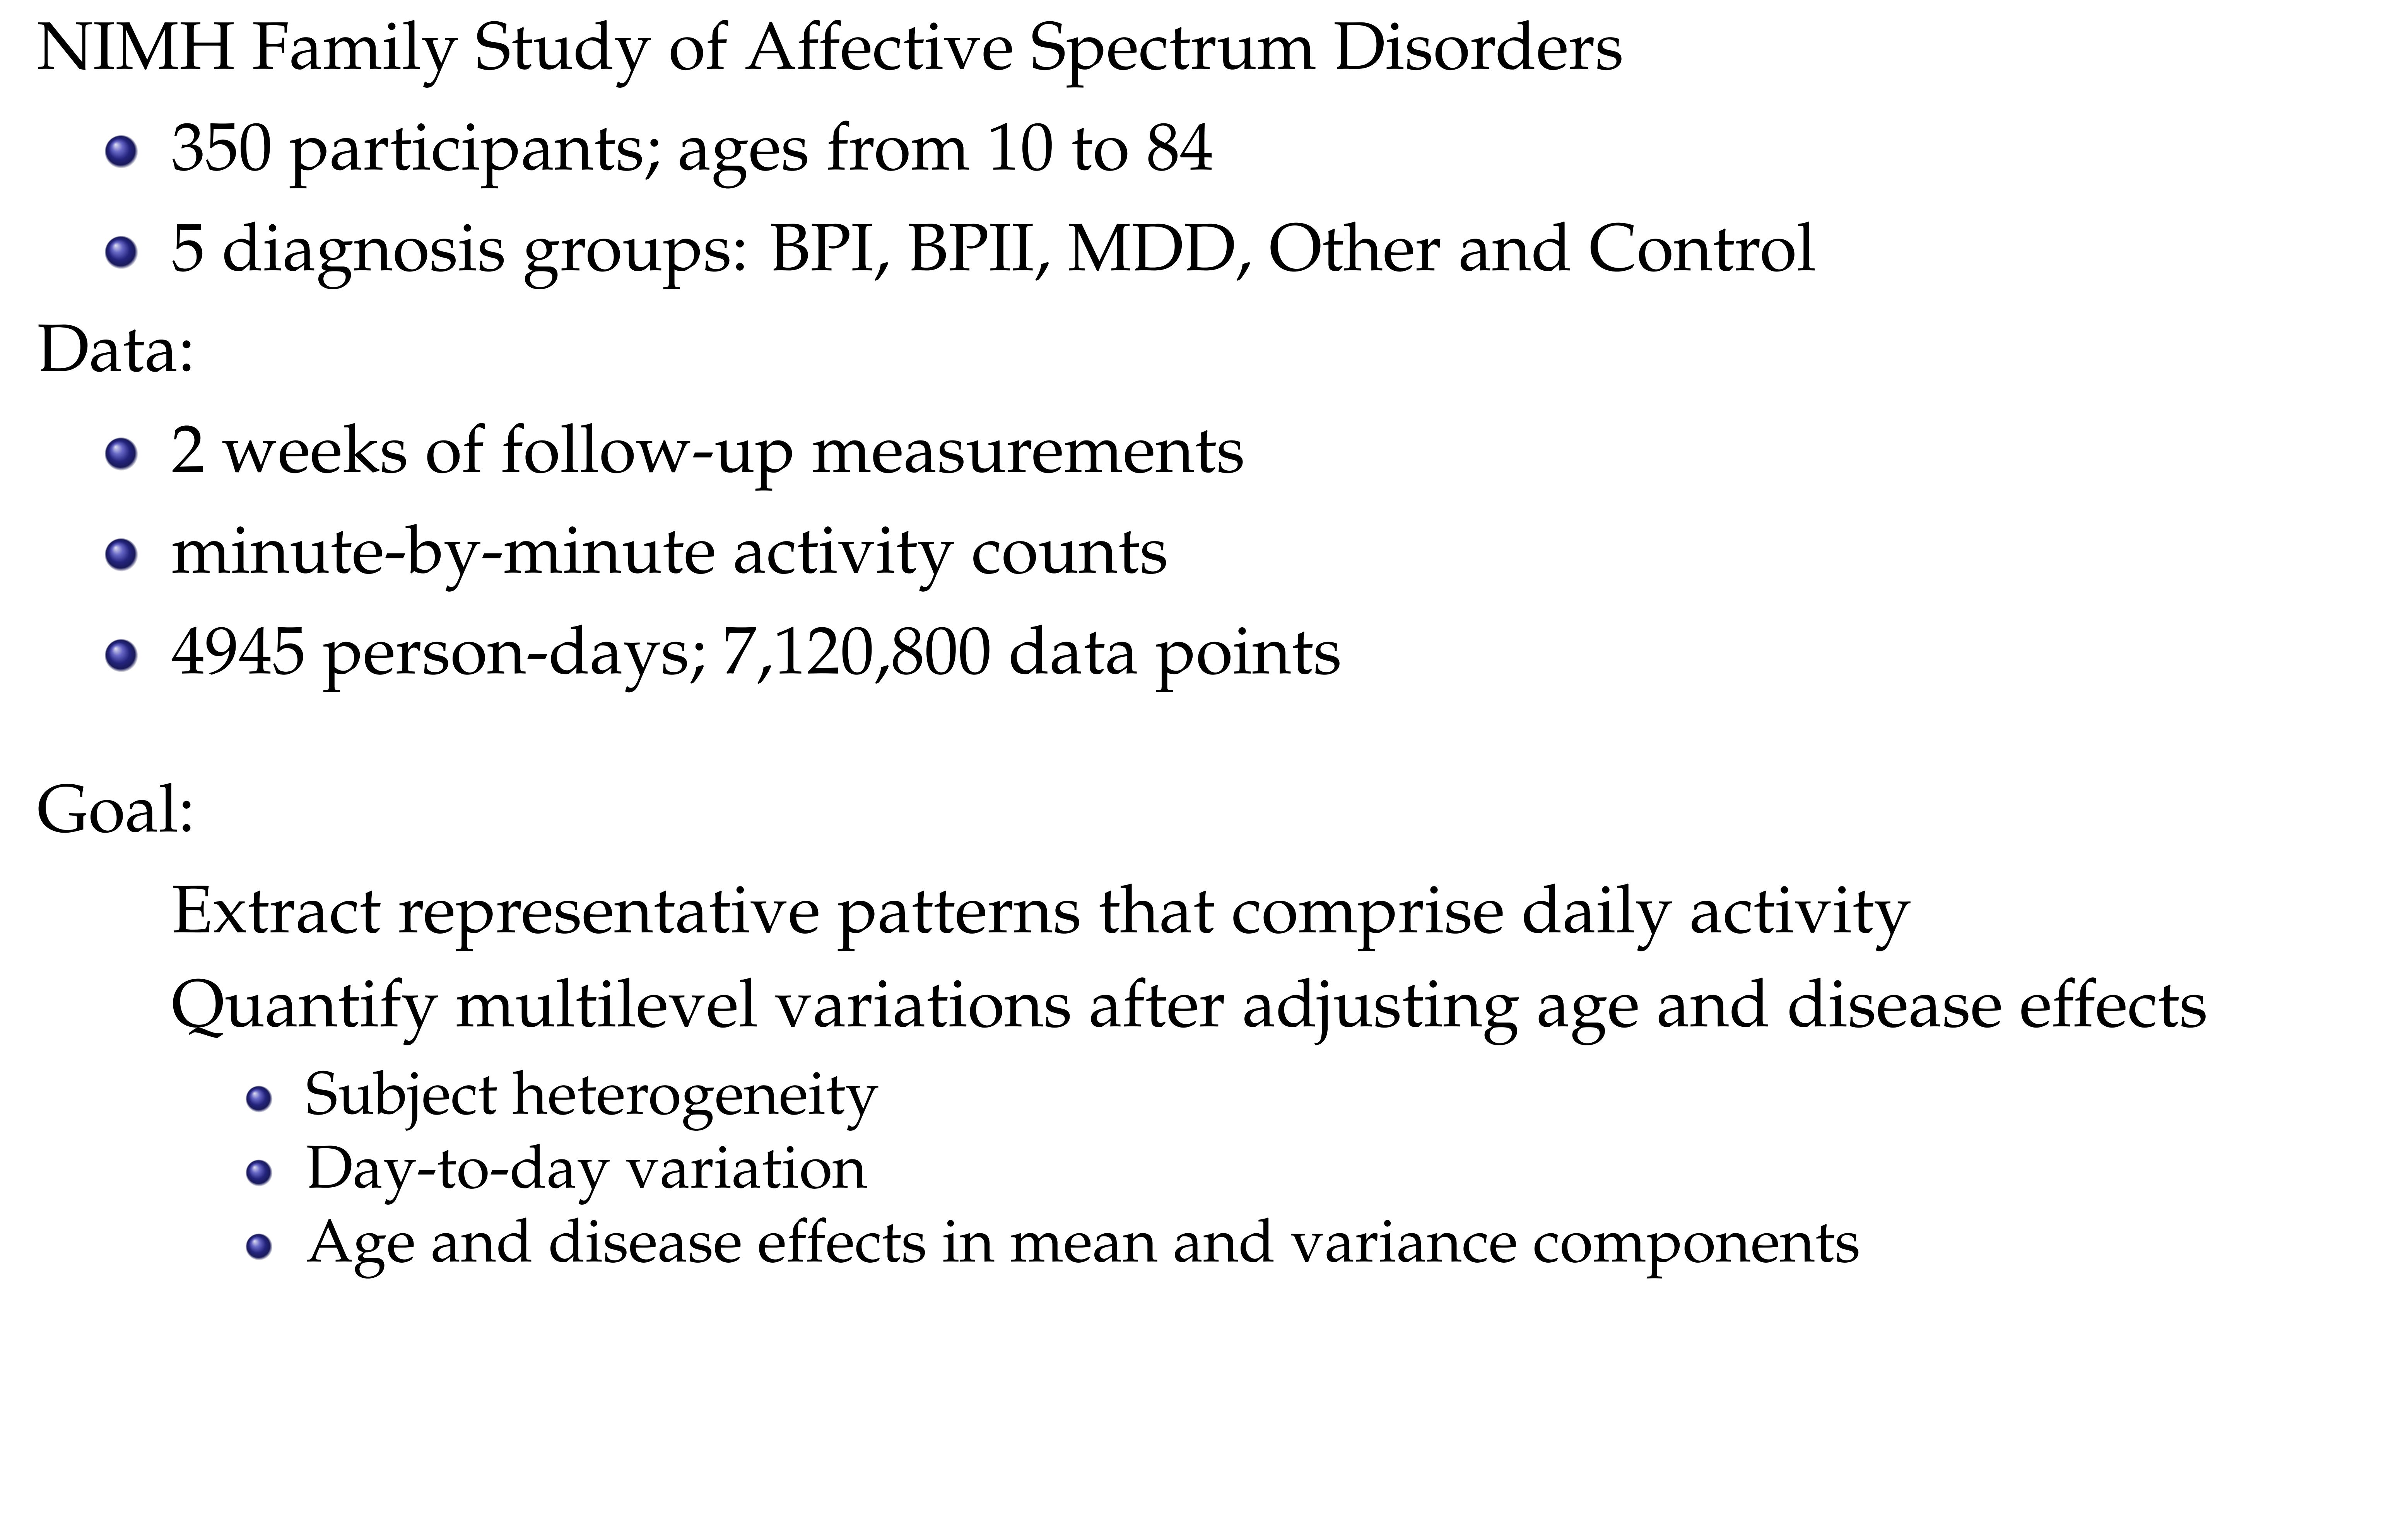

Slide 5
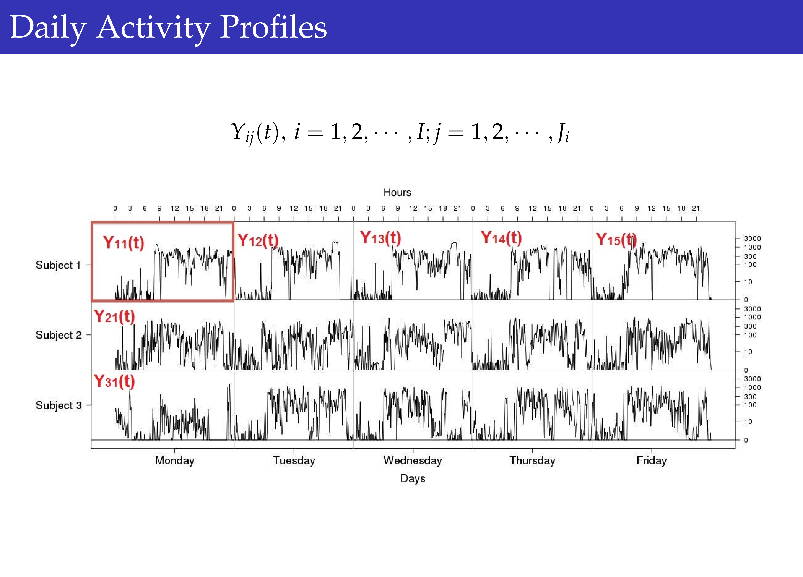

Slide 6
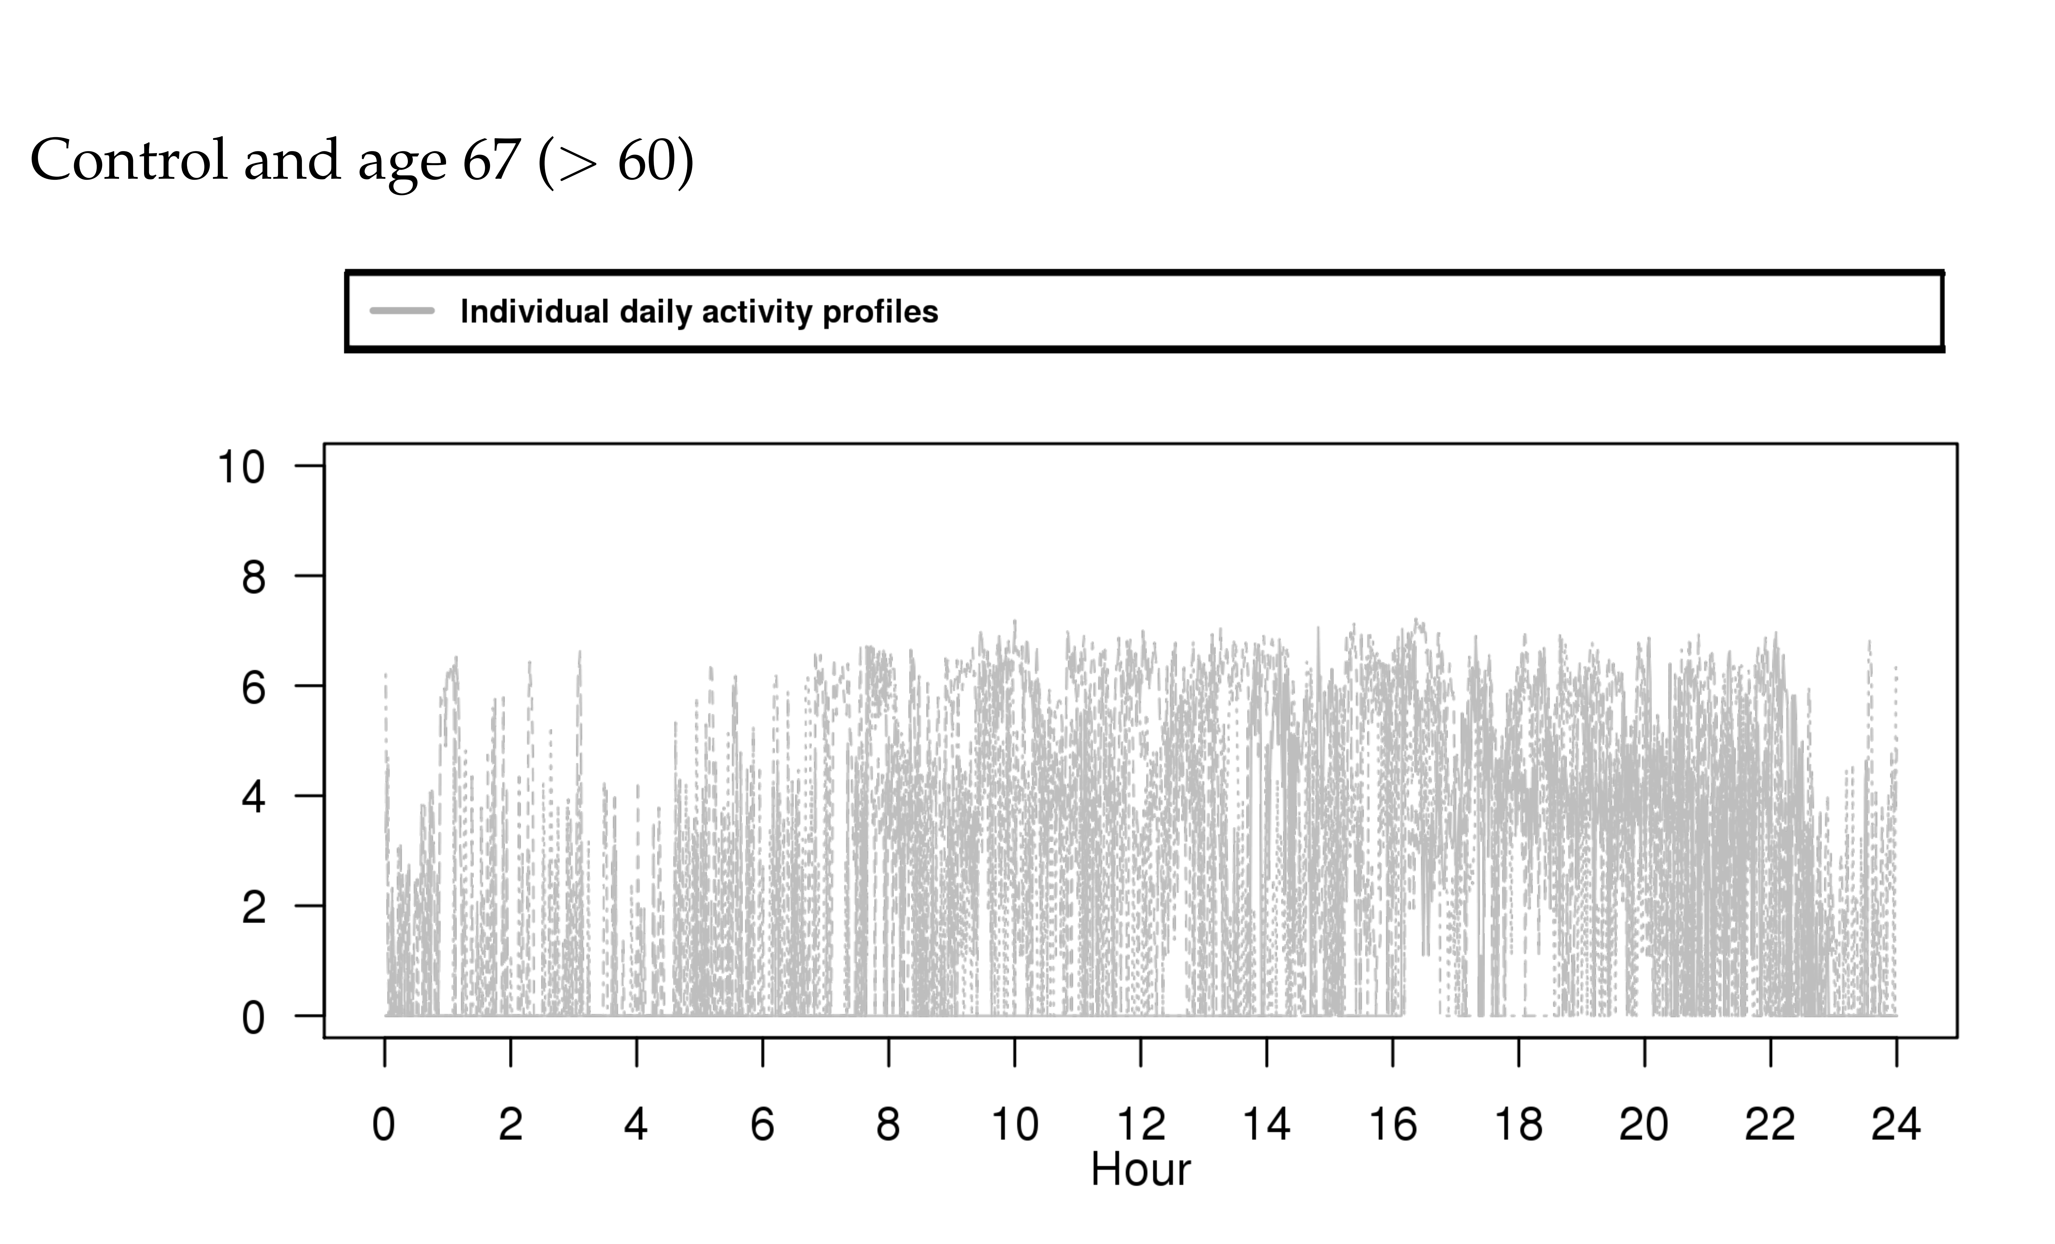

Slide 7
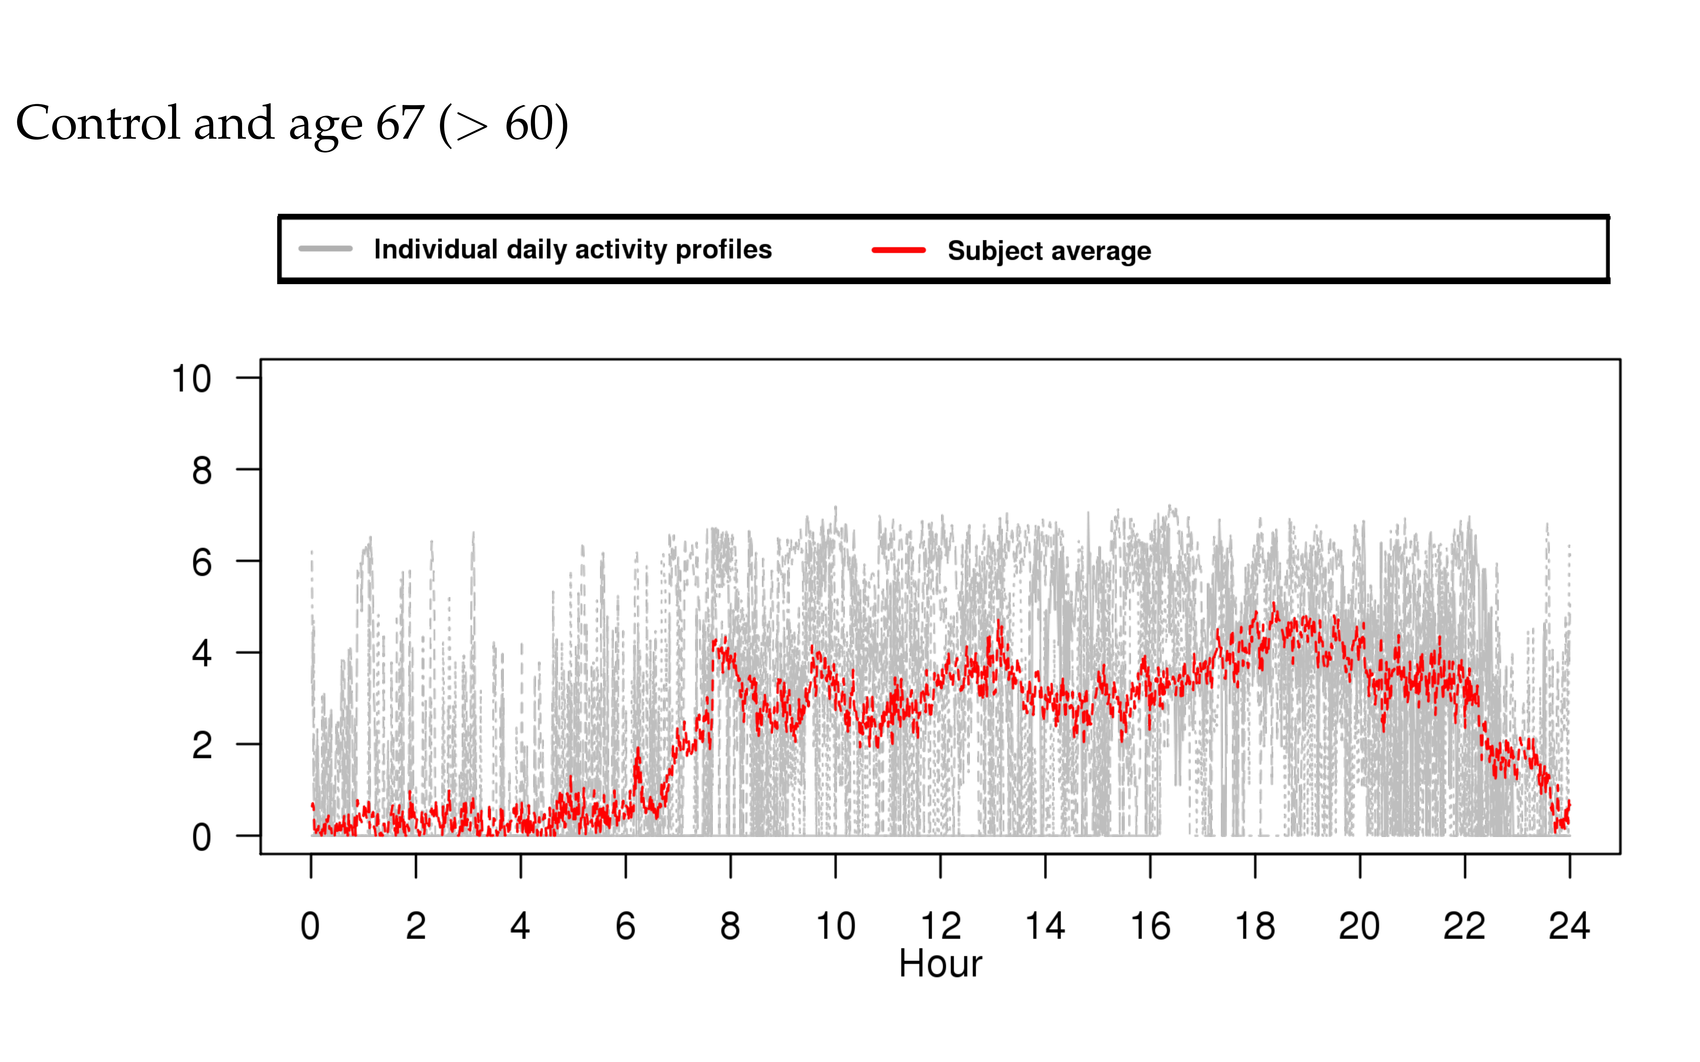

Slide 8
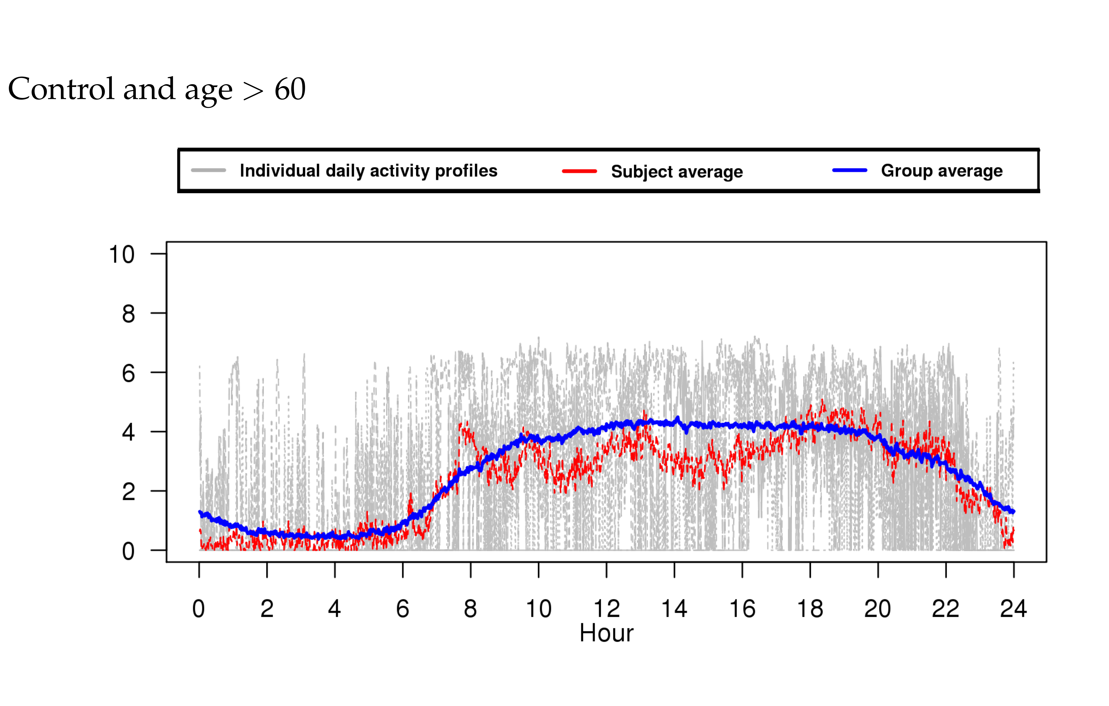

Slide 9
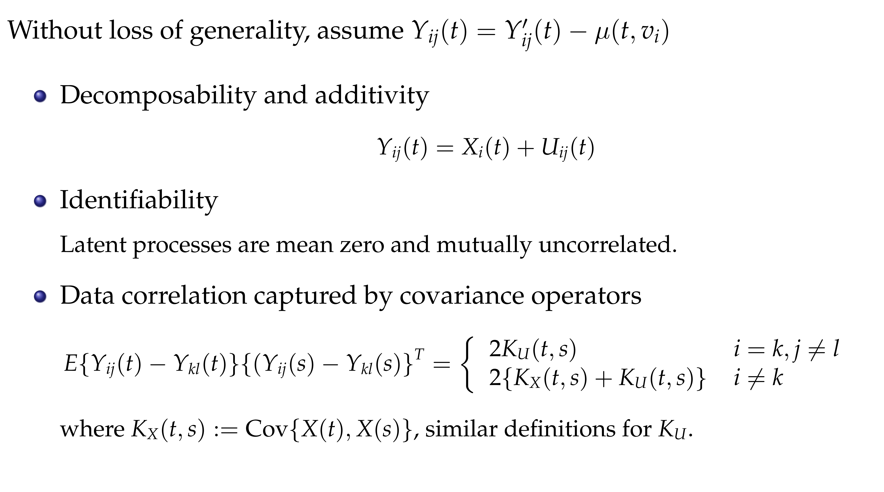

Slide 10
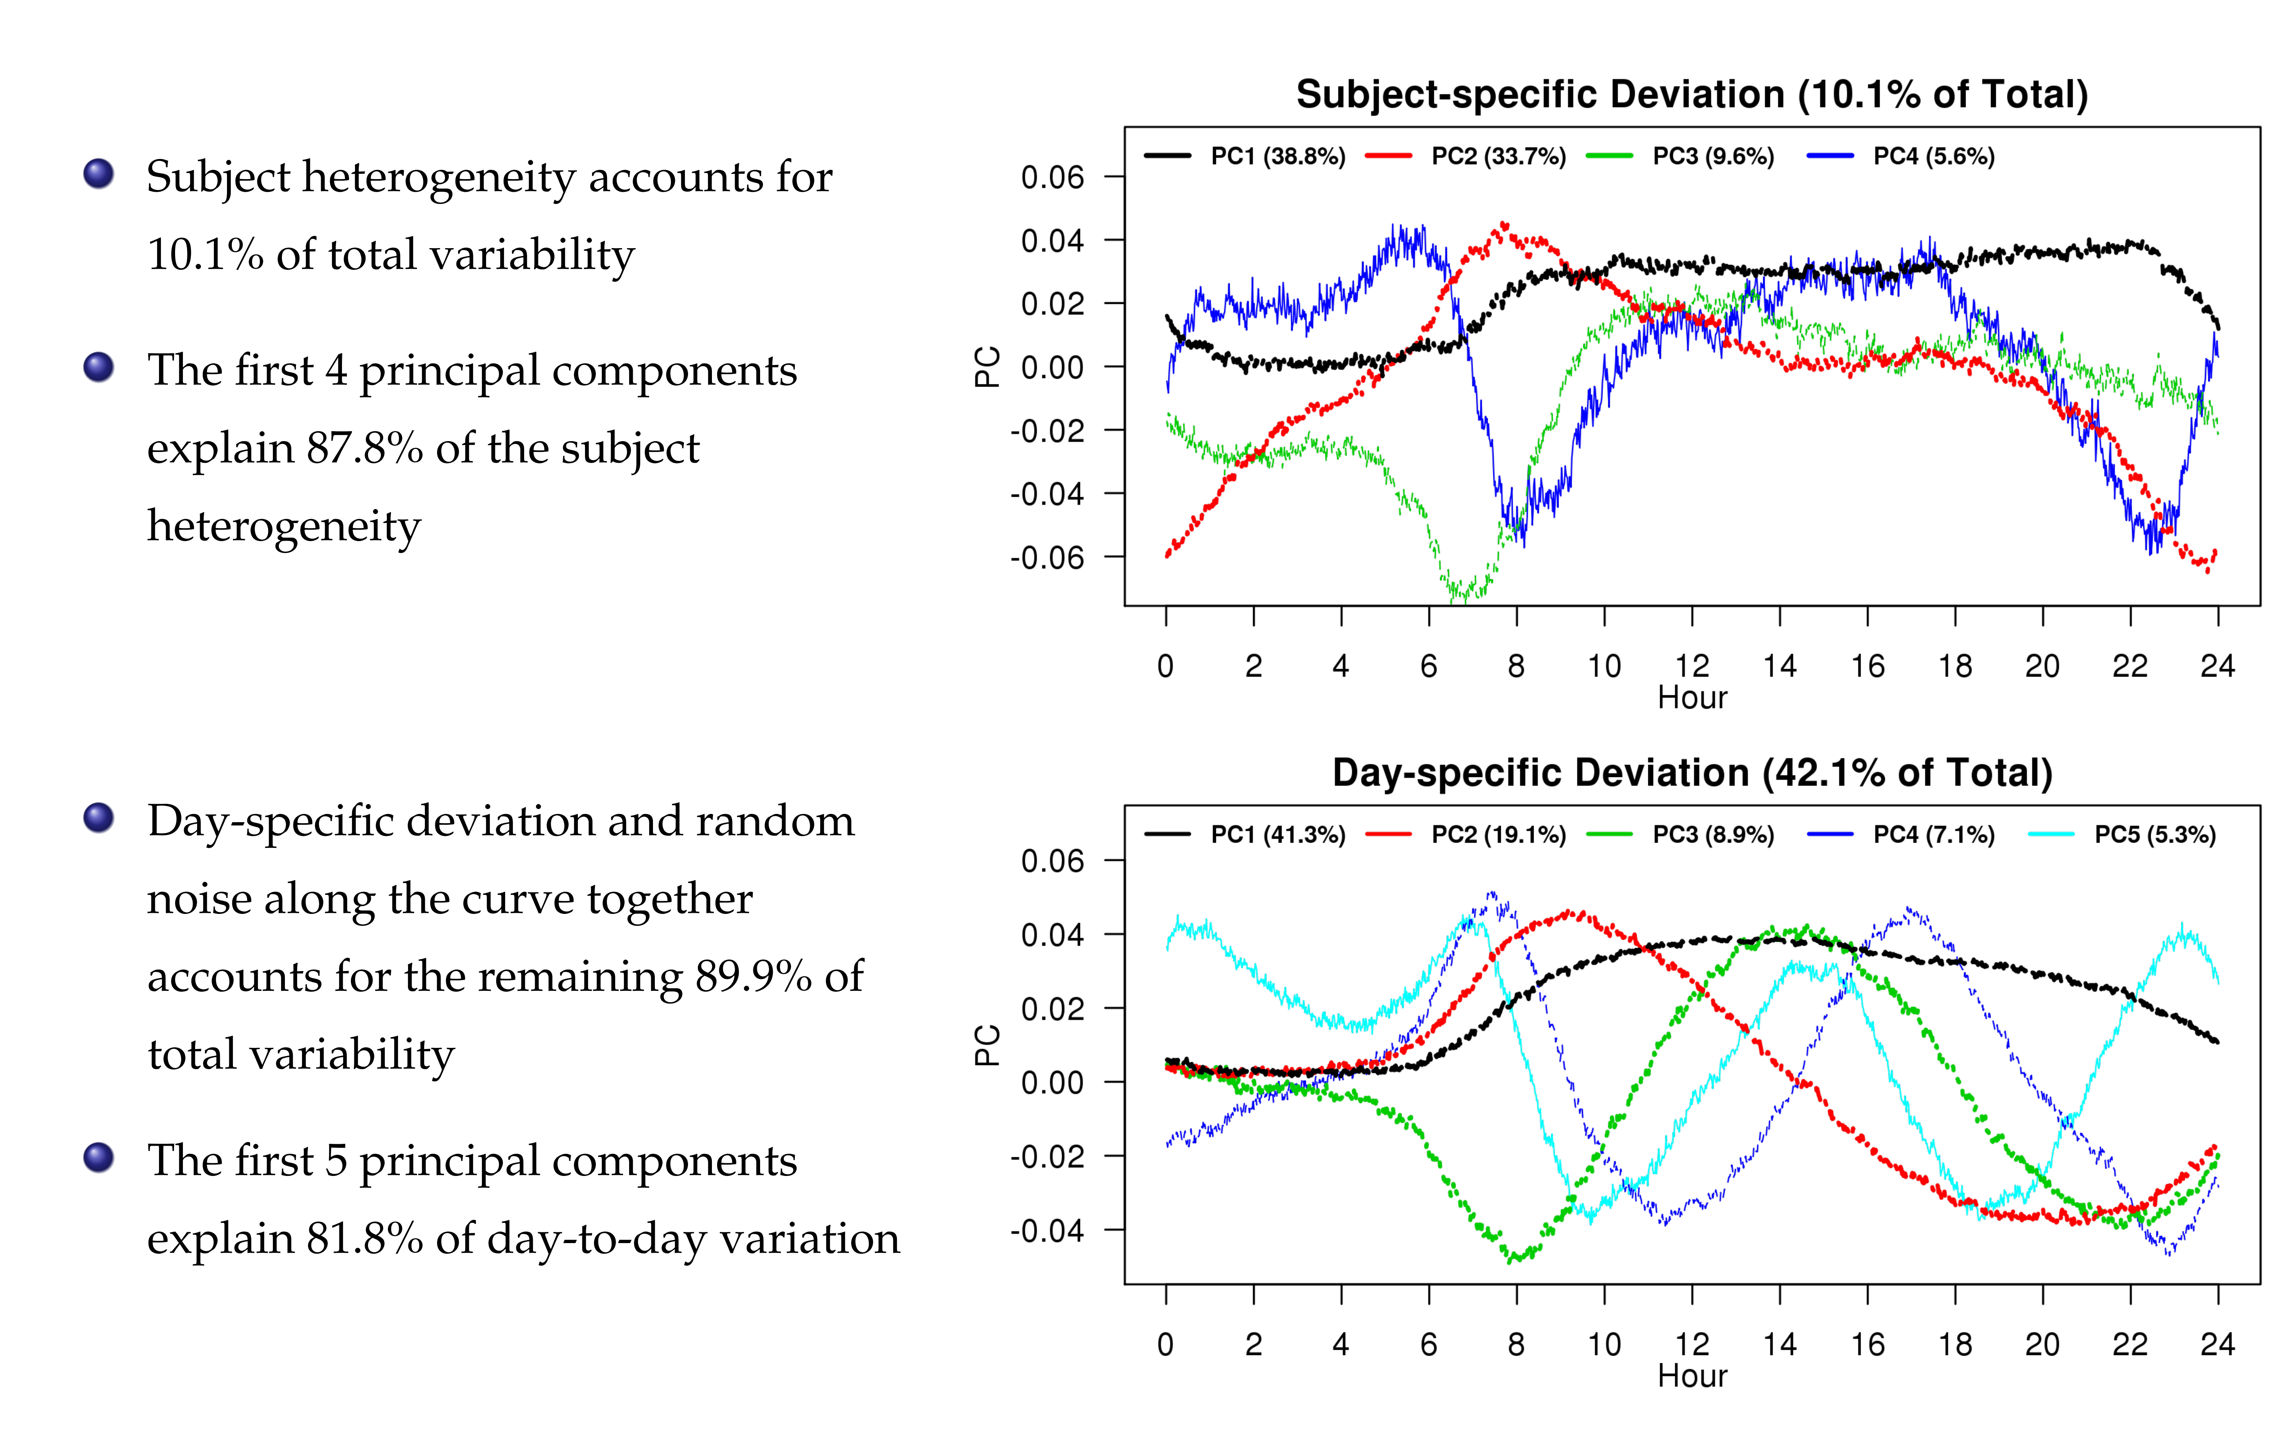

Slide 11
References
Di, C.Z., Crainiceanu, C.M., Caffo, B.S. and Punjabi, N.M., 2009. Multilevel functional principal component analysis. The annals of applied statistics, 3(1), p.458.
Zipunnikov V., Caffo B.S., Yousem D.M, Davatzikos C., Schwartz B.S., Crainiceanu C. (2011),Multilevel Functional Principal Component Analysis for High-Dimensional Data. Journal of Computational and Graphical Statistics, 20(4), pp. 852-873
Shou, H., Zipunnikov, V., Crainiceanu C., Greven, S. (2015) Structured Functional Principal Component Analysis Biometrics, 71 (1), pp. 247-757

Slide 12
Multi-level Generalized Function-on-Scalar Regression and Principal Component Analysis

Slide 13
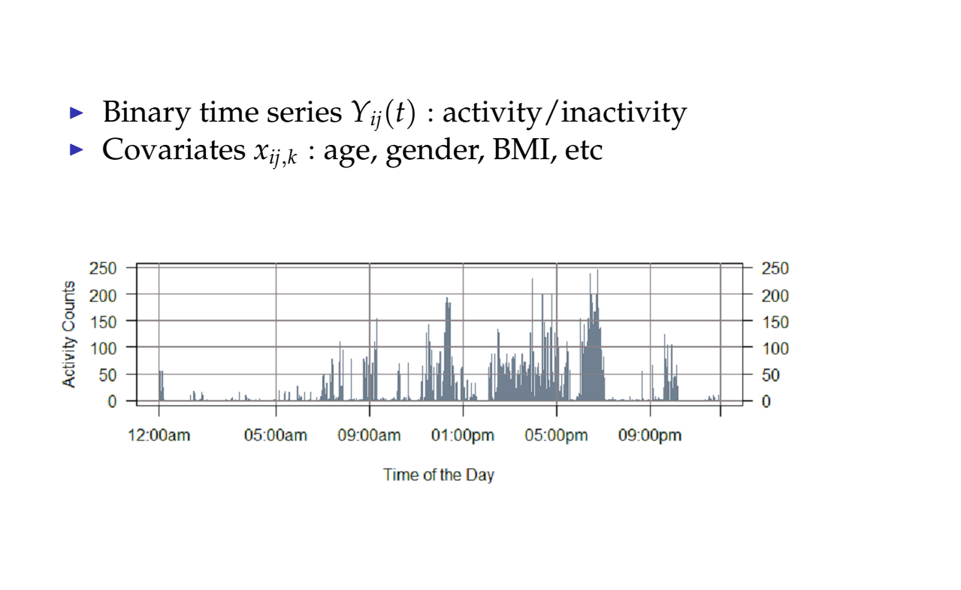

Slide 14
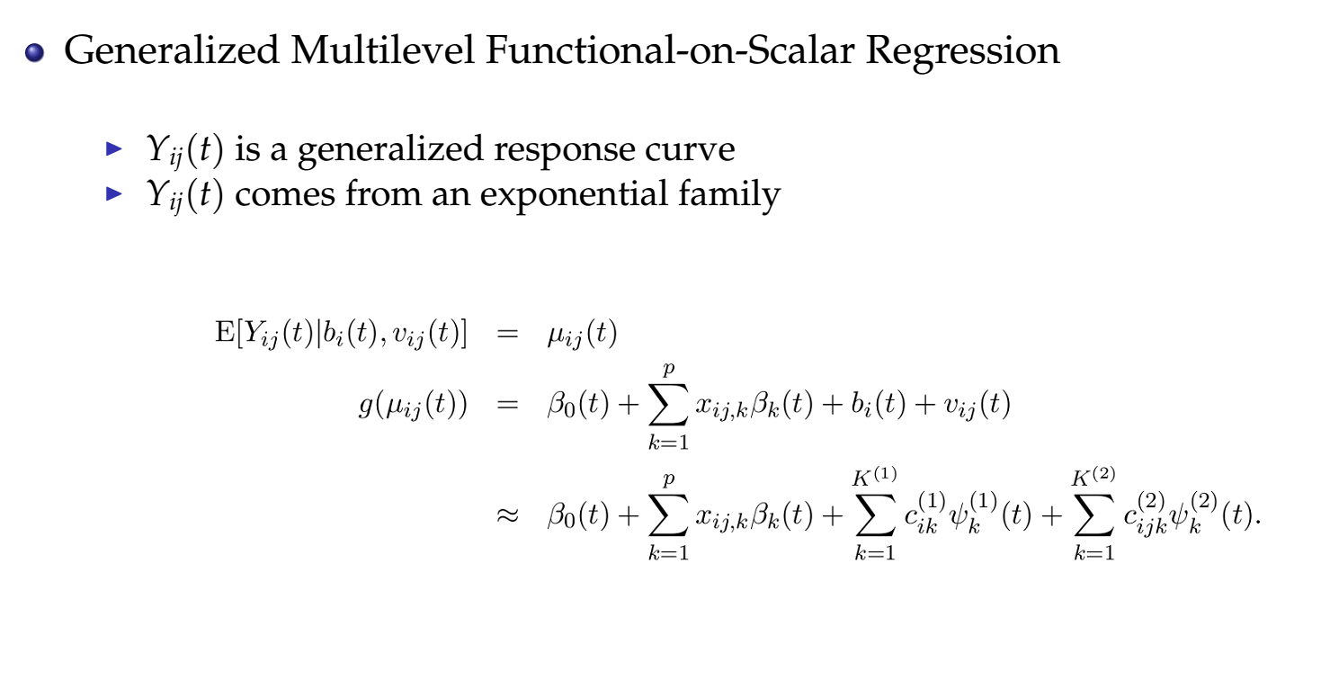

Slide 15
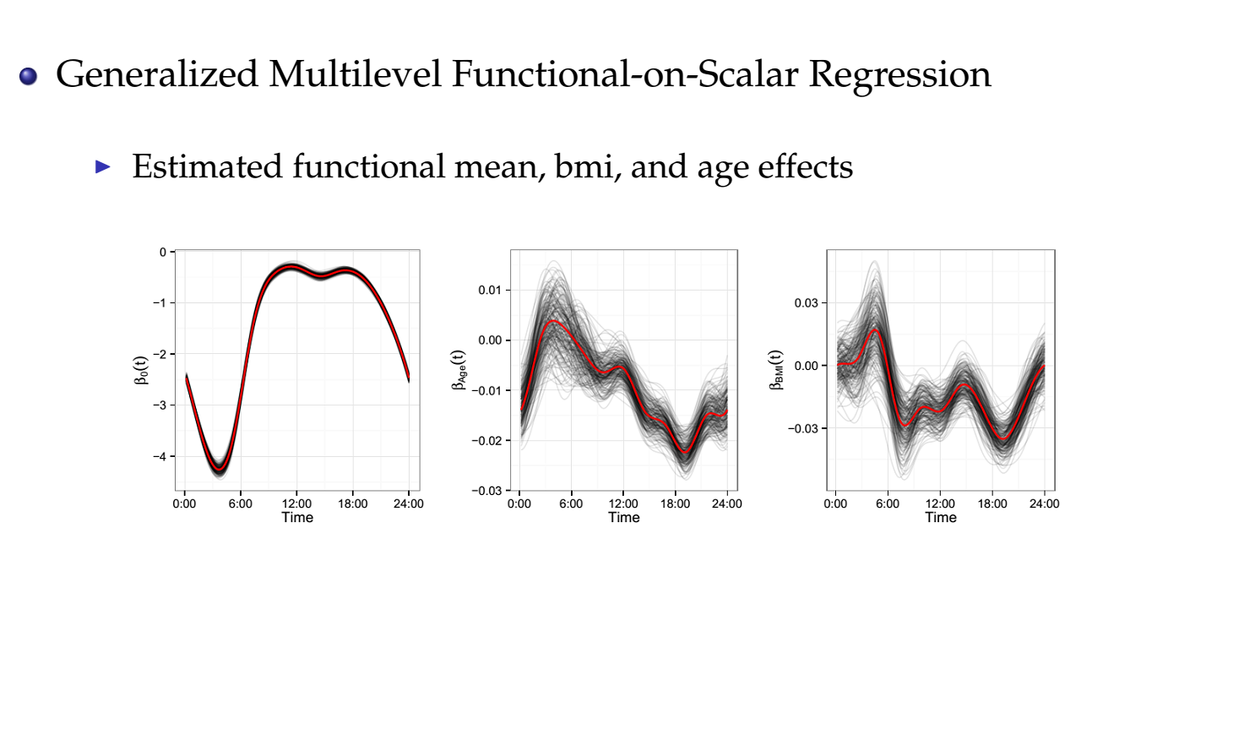

Slide 16
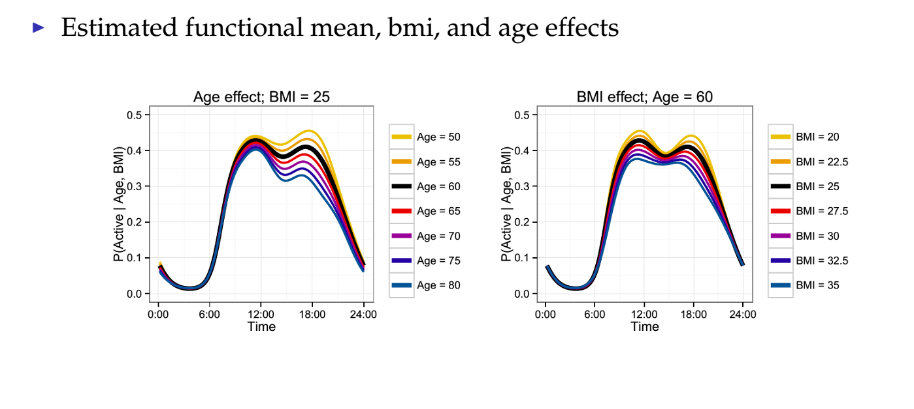

Slide 17
References:
Goldsmith, J., Zipunnikov, V, Schrack, J., Generalized Multilevel Function-on-Scalar Regression and Principal Component Analysis Biometrics, 71 (2), pp. 344-353

Slide 18
Registration of binary (0/1) actigraphy profiles

Slide 19
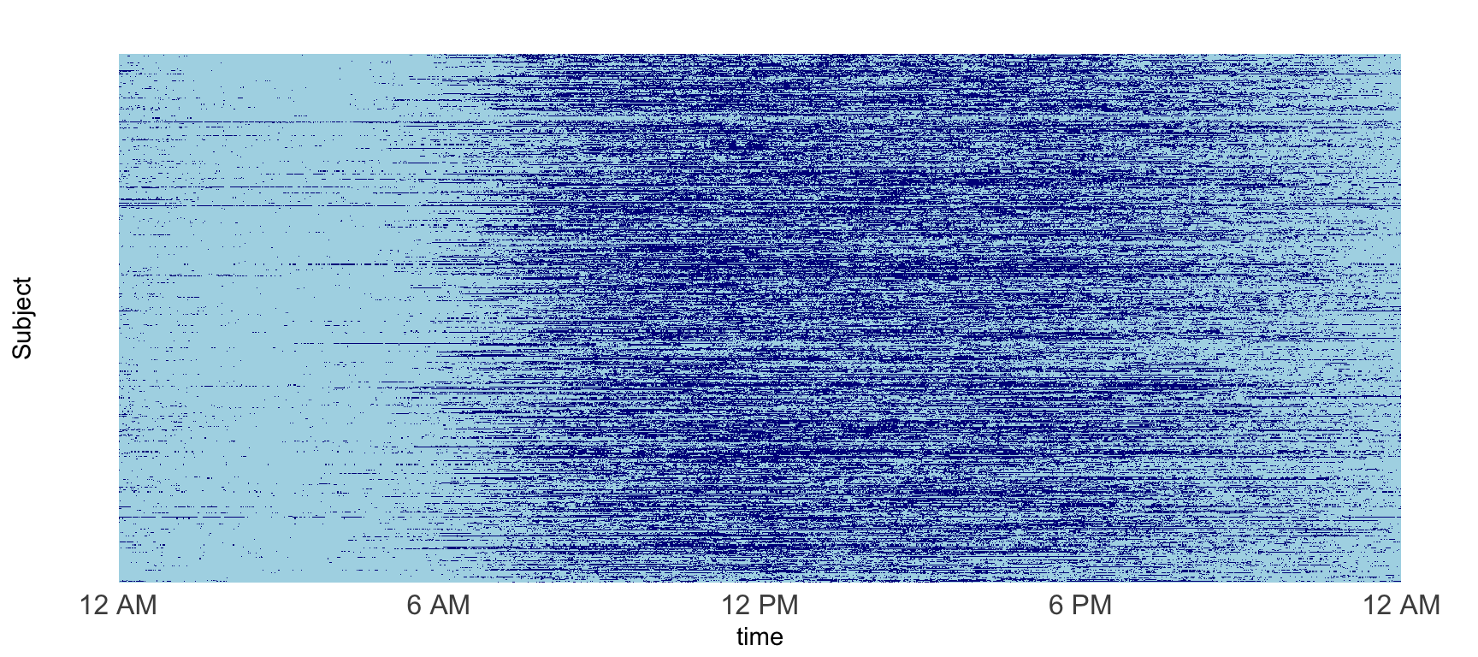
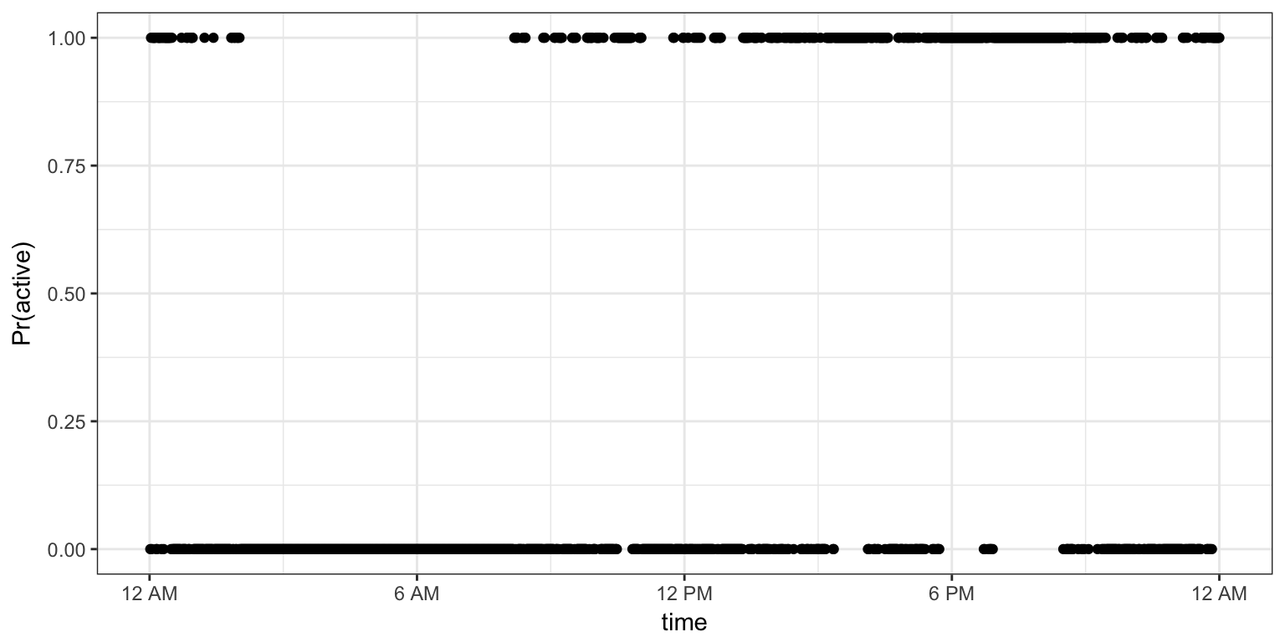
Binary “activity”

Slide 20
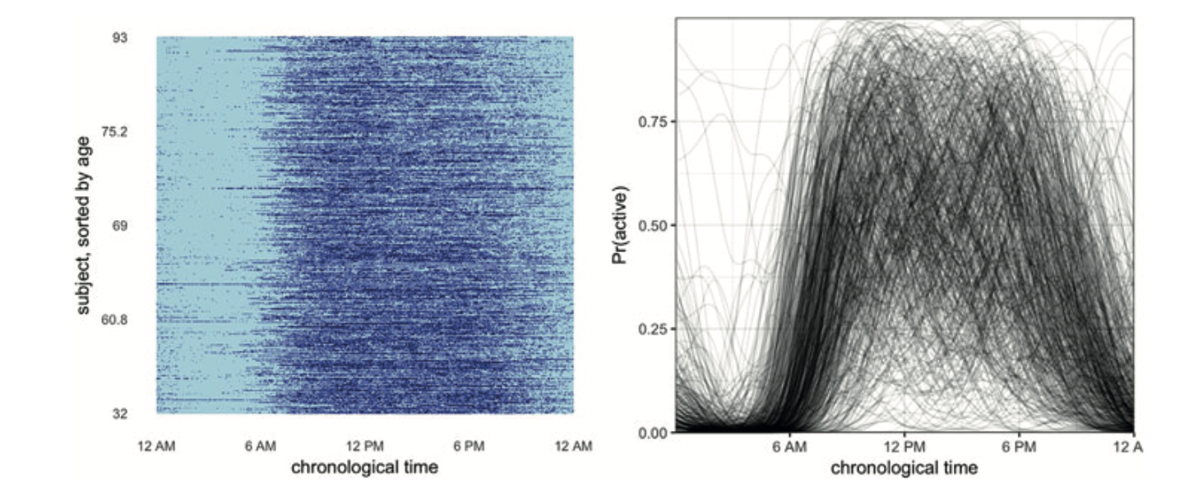
Binary “activity”

Slide 21
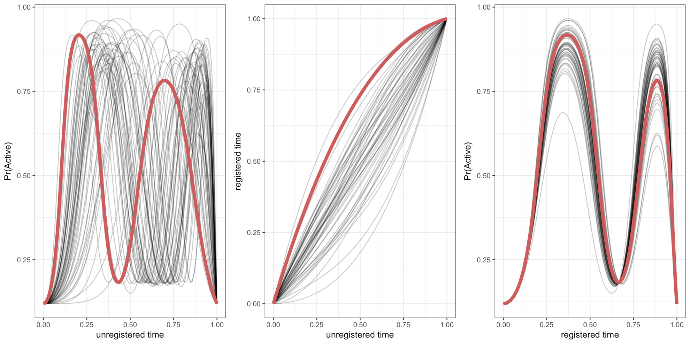
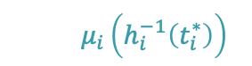
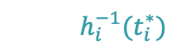
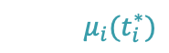
Registration
$$μ_{i}(t_{i}^{∗})$$
$$h_{i}^{−1}(t_{i}^{∗})$$
$$μ_{i}\left(h_{i}^{−1}\left(t_{i}^{∗}\right)\right)$$
Notes:
- Highlight one persons warping function, curves pre and post registration

Slide 22
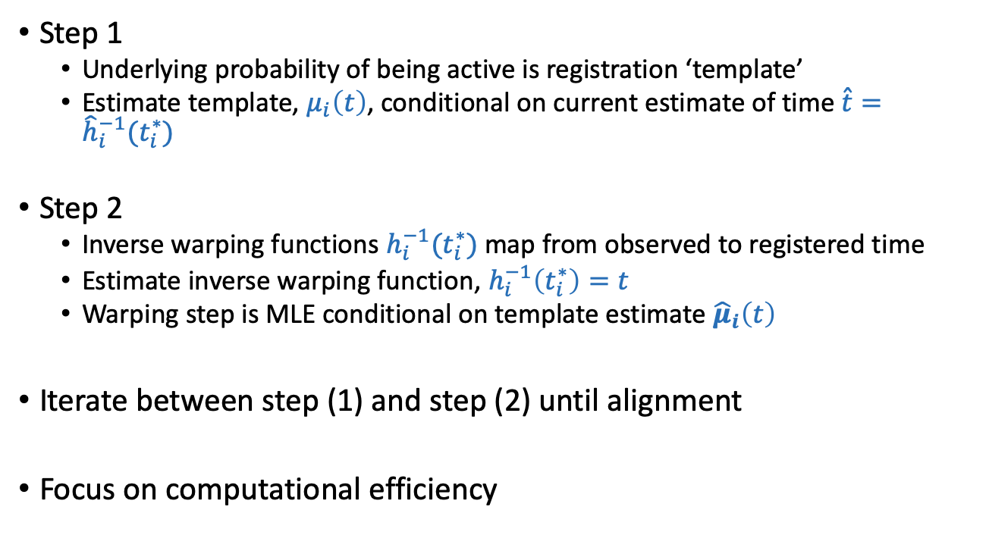
Exponential family registration
Step 1
Underlying probability of being active is registration ‘template’
Estimate template, $μ_{i}\left(t\right)$, conditional on current estimate of time $\hat{t}={\hat{h}}_{i}^{−1}(t_{i}^{∗})$
Step 2
Inverse warping functions $h_{i}^{−1}(t_{i}^{∗})$ map from observed to registered time
Estimate inverse warping function, $h_{i}^{−1}\left(t_{i}^{∗}\right)=t$
Warping step is MLE conditional on template estimate ${\hat{μ}}_{i}\left(t\right)$
Iterate between step (1) and step (2) until alignment
Focus on computational efficiency

Slide 23
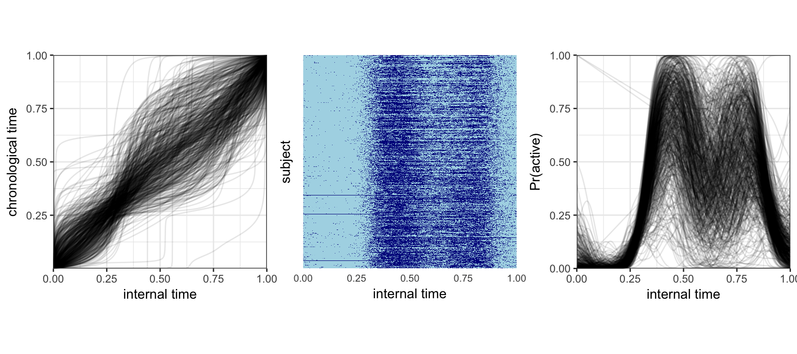
BLSA – post-registration

Slide 24
References:
Wrobel, J., Zipunnikov, V., Schrack, J. and Goldsmith, J., 2019. Registration for exponential family functional data. Biometrics, 75(1), pp.48-57.

